Slide 1
Trader Positioning & Predictive Value
Kevin Green
Colorado State University Global
Course Code: MIS581
Dr. Lisa Bryan
December 4TH , 2022

Slide 2
Background
Commodity exchanges provide individuals the ability to buy and sell goods in a centralized fashion to achieve several different objectives.
The Chicago Mercantile Exchange provides a centralized marketplace where producers, institutional investors, and speculators can trade
“Barclays Capital estimated that exchange traded financial products following such strategies grew from negligible amounts in 2003 to a quarter trillion dollars by 2008.” (Hamilton, J. D., & Wu, J. C., 2015, Abstract).
Each stakeholder that participates on the exchange helps uncover market prices or “value” for commodities
Commodities include Crude Oil, Corn, Natural Gas, among others
Notes:
Commodity exchanges provide individuals to buy and sell different products in order to speculate or hedge a position. The market brings together producers, such as energy companies, institutional investors like Goldman Sachs or J.P. Morgan, and individual investors together to conduct trades. Commodity markets include Oil, corn, natural gas among others. Popularity among retail traders have grown exponentially as Barclays Capital estimates that ETFs had negligible impact on prices in 2003 but has evolved into meaningful capital in 2008 (Hamilton, J. D., & Wu, J. C., 2015, Abstract).

Slide 3

Overview of Study
Figure 1
Offshore oil rig
Commitment of Traders report provides data on market positioning for different categories of traders (Mark J S Keenan, 2020).
The four categories are as follows:
Producer
Swap Dealer
Money Manager
Other Reportables (CFTC, 2022, COT).
Research question: Does the Commitment of Traders report provide any predictive value for crude oil prices?
Note: Adapted from Crude Oil Takes a Breather After Surging on Iran Sanctions, by Robert Tuttle, 2018, Bloomberg (Crude Oil Takes a Breather After Surging on Iran Sanctions - Bloomberg). In the public domain.
Notes:
The research project will use fundamental analysis, specifically, the CFTC’s Commitment of Traders Report dataset. The CFTC (2022) describes the report as: “The Commodity Futures Trading Commission relies on data collected from market participants to conduct all its mission functions including market oversight, monitoring for liquidity and systemic risk, oversight of market participants, regulatory compliance, and enforcement of the CEA” (CFTC, 2022, pg 1). The report provides a detailed breakdown of the market position of several different trader categories. Mark J S Keenan (2020) defines the different categories as follows:
Producer: A producer is an entity that primarily uses futures products to hedge the physical commodity in some fashion such as packing, production, handling or selling a commodity (Mark J S Keenan, 2020). The futures markets allow for Producers to manage the price of future deliveries of a good, making it easier to forecast expenses and revenue.
Swap Dealer (SD): A ‘swap dealer’ uses futures to offset risk with another counterparty like a hedge fund or large corporation to be net neutral on a particular position (Mark J S Keenan, 2020). For instance, they may have an OTC agreement with Kellogg’s to deliver oats to the company and to offset the delivery risk and price risk they may buy a futures contract that would allow them to take delivery or to at least offset price increases in the cash market. Typically, these dealers do not take the physical delivery, but their job is to accept obscure forward agreements and then use traditional financial instruments to offset that risk, usually for a small premium.
Money Manager: A ‘money manager’ is registered with the CFTC or some other regulatory body (Mark J S Keenan, 2020). Their primary goal is to speculate on commodity prices in the hopes of making a profit for their clients. They do not have any intention of actually receiving the physical commodity.
Other Reportables: If a trader does not meet the definition of a producer, swap dealer, or money manager, then they will be considered an Other Reportable (Mark J S Keenan, 2020). These traders are speculators in the marketplace but may still hold significant positions that could influence market prices significantly.
The study will focus on proving, with a significant amount of certainty, that market positioning has predictable value for forecasting future prices of crude oil. The research will utilize the Commitment of Traders report which is produced by the CFTC (CFTC, 2022). The study will focus on the long and short positions of each category of trader within the report and compare those variables to the price of crude on the day the report is released with the hopes of uncovering predictable value.

Slide 4
Methodology
Market Efficiency Theory contends that current prices within the marketplace reflect all available information.
The Commitment of Traders report is publicly available, published every Friday at 3:00pm ET, and has been used for studies since its inception (Mark J S Keenan, 2020).
To collect the data the researcher downloaded the dataset as a CSV directly from the CFTC website.
The Commitment of Traders report is a time series dataset, and the timeframe from July 18th, 2006, to September 27th, 2022, has been used to test the hypotheses offered in the research paper.
The timeframe selected includes several different economic, social, and geopolitical events that have impacted not only price, but market positioning. For example: February 2022 Russia officially invaded Ukraine which resulted in a spike in oil prices
Notes:
The Market Efficiency Theory contends that current prices within the marketplace reflect all available information, and there are no other ways to gain an advantage within the marketplace by analyzing new data to gain insights to outperform the market (Investopedia.com, 2022, Market Efficiency Theory). The Commitment of Traders report is the standard used within the commodity market to identify market trends by market participants. The use of this dataset provides a widely acceptable dataset that is used with a high degree of confidence by professionals within the industry. The report is released at 3:30 p.m. Eastern time every Friday excluding any holiday disruptions (CFTC, 2022). To collect the data the researcher downloaded the dataset as a CSV directly from the CFTC website. This is a series dataset so selecting random sample dates would not be appropriate as it would degrade the testing methods. The timeframe selected includes several different economic, social, and geopolitical events that have impacted not only price, but market positioning.

Slide 5
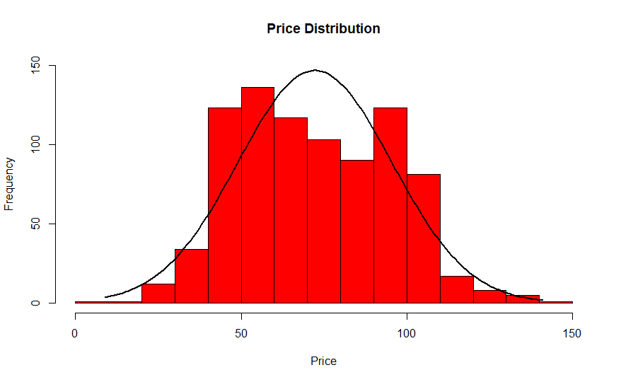
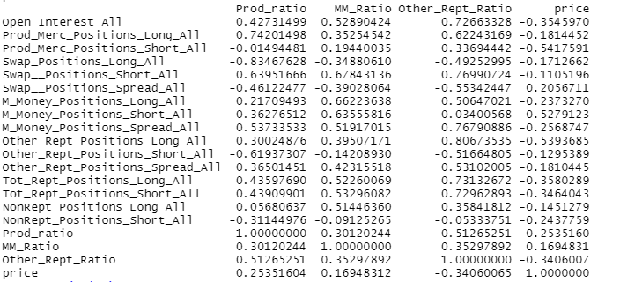
Methods
Figure 2
Histogram reflecting price distribution of the dataset
Simple T-test on the dataset shows the normality of price distribution. (Qualtrics, 2022)
Key to ensure bias is reduced if another subsection of the data is used for a model
Pearson Correlation test was completed on the dataset to identify collinearity between two variables (Leard Statistics, 2022)
Price variable is the dependent variable within the study
Several variables showed a small relationship to price: Producer Long Position and Money Manager Long Position
Figure 3
Pearson Correlation Results
Notes:
Pearson Correlation is used to measure the linear correlation between two datasets. The Pearson Correlation does not automatically qualify or disqualify a variable’s effectiveness to creating a model, especially for other models like neural networks or support vector machines. A T-test was used to check the distribution of the dependent variable to ensure normality within the dataset.

Slide 6
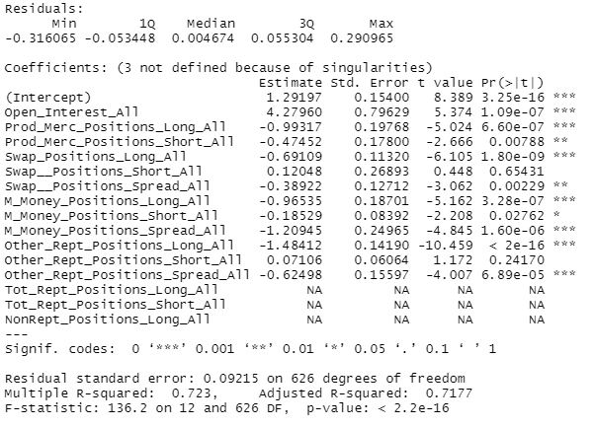
Linear model
Figure 4
Summary of the linear model
Linear Model identified several different variables that had significant impact on predicting price:
Swap Long Position
Producer Long Position
Money Manager Long Position
Results:
Adjusted R-Squared showed the model to be 71.77% accurate
Mean Squared Error: 901.5258
RMSE: 30.02542
Model proved to be effective in low volatility markets, but significant price swings drastically impacted predictive performance
Notes:
The linear model was created to show the predictability value of the independent variables compared to the dependent variable Price. The model was trained on a training dataset that included 639 of the 852 observations which equates to 70% of the total dataset. The model resulted in an Adjusted R-squared value of 71.77% which equates to the quality of the model. Although the model performed better than an Adjusted R-squared value of 50% which is the equivalent of a coin flip, the quality of the model is below industry expectations.

Slide 7
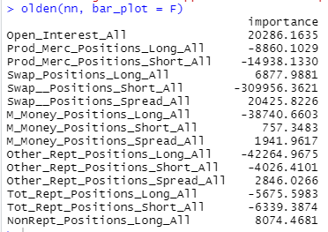
Neural Network
Figure 5
Neural network variables of importance
The Neural Network was designed by using the “neuralnet” package within R Studio
Construction:
10 hidden layer1 nodes
5 hidden layer 2 nodes
2 hidden layer 3 nodes
Results:
Mean Squared Error: 32.2697
RMSE: 5.659238
Model improved dramatically compared to the linear model. Disadvantage of the model is the amount of time to train.
Notes:
The dataset was also tested with a simple Neural Network to see if machine learning techniques could improve the predictability value of the independent variables. The Neural Network was created in R Studio with the neuralnet package. The model had 19 input layers, 10 hidden layer 1 nodes, 5 hidden layer 2 nodes, and 2 hidden layer 3 nodes to ensure accuracy of the model. Significant variables include: Swap Short Position, Other Reportable Long Position, and total Open Interest.

Slide 8
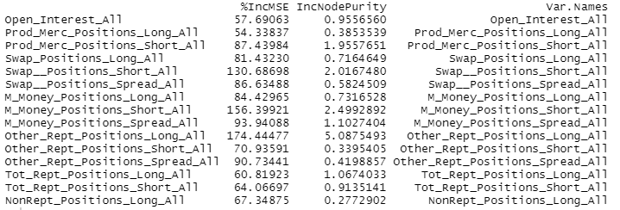
Random Forest
Figure 6
Variable importance for Random Forest model
Random Forest identified several different variables that had significant impact on predicting price:
Other Reportable Long
Swap Position Short
Money Manager Short
Results:
Mean Squared Error: 31.14116
RMSE: 5.580426
Model proved to be the most accurate from each model tested.
Notes:
The Random Forest model provided the best accuracy out of each model used in the study. The Random Forest was created in R Studio by using the “randomForest” package. The model had 10,000 trees to start the model and was fitted with the training dataset. Random Forest models are great because of their ease of implementation, not prone to overfitting, and they have a wide range of optimization features.

Slide 9
Conclusion
Although simplistic models such as linear regression may not prove to be the best to predict future values of oil based on the Commitment of Traders report, it does provide some value for those looking to incorporate the report into broader models
The crude oil market, among others, are influenced by market participants and the basic forces of supply and demand.
Even though we found predictive value in the Commitment of Traders report, it does not fully explain current pricing
Due to the delay of the release of the report, their may be a decaying factor associated with the information contained in the report due to these other factors described.
Notes:
The Commitment of Traders report interprets supply and demand by highlighting market participant positioning as a proxy to convey demand side influences by using quantitative data. The simplistic models used within the research project show that the report provides some predictive value. There is a risk of decay in the value of the report as time goes on. There may be other variables that may be utilized to improve predictability.

Slide 10
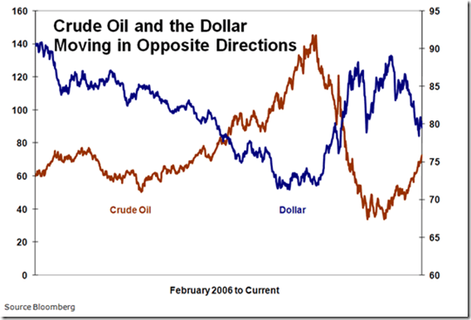
Recommendations
Figure 7
Relationship between U.S. Dollar & Oil Prices
Based on the model techniques, Random Forest, appears to be best performing model out of the three and tends to be a popular framework for quantitative traders.
As the Commitment of Trader report evolves and more market participants enter the marketplace the influence of each independent variable will change over time and a key obstacle that quants will need to address is the ability to scale the data in a way that minimizes bias.
Potentially exploring ratios to reflect the net positioning of a trader class or some other weighting mechanism to reduce bias.
Investors continue to gain access to commodity markets either directly or indirectly, but the amount of land to produce goods is finite, so over time Producers’ share of total Open Interest will degrade
Other input variables to consider: Weather patterns, Rig Count, Import/Export quantity values, and currency prices
Note: Relationship between U.S. Dollar & Oil Prices
by N Saxena, 2012,. https://nitinsaxena.wordpress.com/category/crude-oil/
Notes:
For an organization or retail trader that is looking at incorporating the Commitment of Traders report into their trading strategy or utilizing it within a current price predicting model there is value of using the contents within the report based on the finding of the research study. Independent variables such as Producer Long position, Money Manager Long Position, and Other Reportable Long Positions have proven to have some predictive value within the models explored within the research study. Investors continue to gain access to commodity markets either directly or indirectly, but the amount of land to produce goods is finite, so over time Producers’ share of total Open Interest will degrade, although they’re the biggest component within the futures markets to hedge risk for physical crops or goods. Tuning models such as the neural network and random forest could also improve predictability. There is a risk of overfitting the neural network. Other input variables to consider: Weather patterns, Rig Count, Import/Export quantity values, and currency prices.

Slide 11
References
Keenan, Mark J. (2020). Advanced positioning, flow and sentiment analysis in commodity markets: Bridging Fundamental and technical analysis. Wiley.
Commitments of traders. CFTC. (n.d.), from https://www.cftc.gov/MarketReports/CommitmentsofTraders/index.htm
Introduction to T-test theory and use cases. Qualtrics. (2022, October 26)., from https://www.qualtrics.com/experience-management/research/t-test-analysis
Pearson product-moment correlation. Pearson Product-Moment Correlation - When you should run this test, the range of values the coefficient can take and how to measure strength of association. (n.d.), from https://statistics.laerd.com/statistical-guides/pearson-correlation-coefficient-statistical-guide.php
Hamilton, J. D., & Wu, J. C. (2015). Effects of Index-Fund Investing on Commodity Futures Prices. International Economic Review, 56(1), 187–205. https://doi.org/10.1111/iere.12099

